Slide 1
JavaScript Events
CS 261
Presented by Amy Cook

Slide 2
JavaScript Events are “things” that happen to HTML elements

Slide 3
JavaScript Events are “things” that happen to HTML elements
Events are a way to interact with the user on the page

Slide 4
JavaScript Events are “things” that happen to HTML elements
Events are a way to interact with the user on the page
Events listen for something specific to happen and react in some way.

Slide 5
JavaScript Events are “things” that happen to HTML elements
Events are a way to interact with the user on the page
Events listen for something specific to happen and react in some way.
HTML elements
<div onfocus=“changeColor( )”>
<p onmouseover=“highlight( )”>
<button onclick=“getInfo( )”>
<input onsubmit=“return validate( )”>
<body onload=“hideElement( )”>
<video onended=“endMessage( )”>

Slide 6
Event Types
Project guidelines: “I expect events from at least three different families of event.”

Slide 7
Event Types
Project guidelines: “I expect events from at least three different families of event.”
https://www.w3schools.com/jsref/dom_obj_event.asp
See “Belongs To” column
Click on an event type to go to a page with all events of that type
Click on an event name to go to a page with examples of that event

Slide 8
Event Types
Project guidelines: “I expect events from at least three different families of event.”
https://www.w3schools.com/jsref/dom_obj_event.asp
See “Belongs To” column
Click on an event type to go to a page with all events of that type
Click on an event name to go to a page with examples of that event
Some simple ones to try:
MouseEvent
KeyboardEvent
UiEvent
FocusEvent

Slide 9
Event Types
Project guidelines: “I expect events from at least three different families of event.”
https://www.w3schools.com/jsref/dom_obj_event.asp
See “Belongs To” column
Click on an event type to go to a page with all events of that type
Click on an event name to go to a page with examples of that event
Some simple ones to try:
MouseEvent
KeyboardEvent
UiEvent
FocusEvent
** TouchEvents are for
touch screens only!

Slide 10
MouseEvent
onclick - 1
Executes JavaScript when the left mouse button is clicked
-- onmouseup and onmousedown =
Left, middle, or right mouse buttons

Slide 11
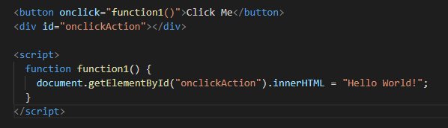
MouseEvent
onclick - 1
Executes JavaScript when the left mouse button is clicked
-- onmouseup and onmousedown =
Left, middle, or right mouse buttons

Slide 12
MouseEvent
onclick - 2
Executes JavaScript when the left mouse button is clicked
onmouseup – left and middle mouse buttons are clicked
onmousedown – left, middle, and right mouse buttons are clicked

Slide 13
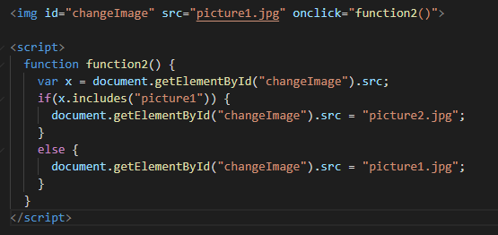
MouseEvent
onclick - 2
Executes JavaScript when the left mouse button is clicked
onmouseup – left and middle mouse buttons are clicked
onmousedown – left, middle, and right mouse buttons are clicked

Slide 14
MouseEvent
onmouseover
Executes JavaScript when the cursor is placed over an element

Slide 15
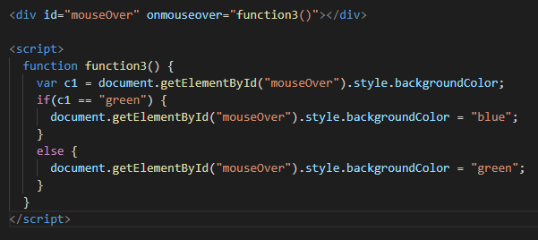
MouseEvent
onmouseover
Executes JavaScript when the cursor is placed over an element

Slide 16
MouseEvent
onmouseout
Executes JavaScript when the cursor is sent away from an element

Slide 17
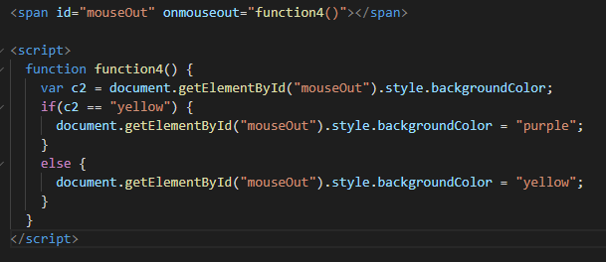
MouseEvent
onmouseout
Executes JavaScript when the cursor is sent away from an element

Slide 18
KeyboardEvent
onkeyup
Executes JavaScript when the user presses a key
onkeydown – event occurs when user is pressing a key
onkeypress – event occurs when user presses a key
onkeyup – event occurs when the user releases a key

Slide 19
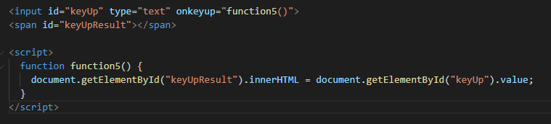
KeyboardEvent
onkeyup
Executes JavaScript when the user presses a key
onkeydown – event occurs when user is pressing a key
onkeypress – event occurs when user presses a key
onkeyup – event occurs when the user releases a key

Slide 20
UiEvent / Event
onload
Executes JavaScript when an element has loaded

Slide 21
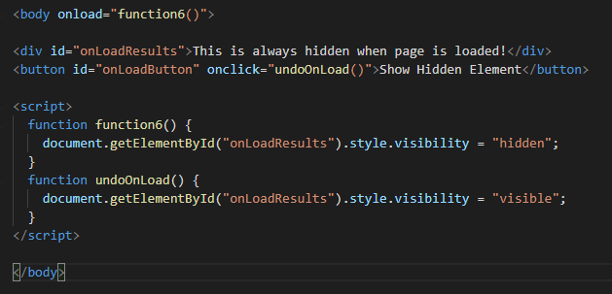
UiEvent / Event
onload
Executes JavaScript when an element has loaded

Slide 22
Event
onplay / onpause
Executes JavaScript when media has started to play or is paused

Slide 23
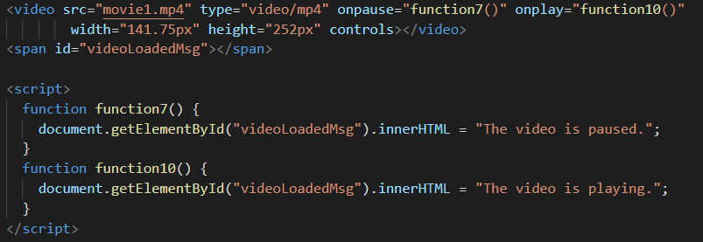
Event
onplay / onpause
Executes JavaScript when media has started to play or is paused

Slide 24
FocusEvent
onfocus
Executes JavaScript when an element gets focus
onblur
Executes JavaScript when an element loses focus

Slide 25
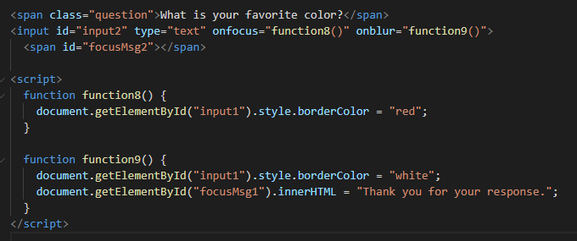
FocusEvent
onfocus
Executes JavaScript when an element gets focus
onblur
Executes JavaScript when an element loses focus

Slide 26
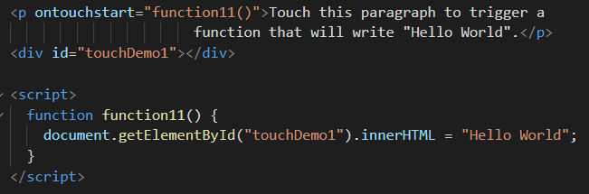
TouchEvent
ontouchstart
Executes JavaScript when a user touches an element

Slide 27
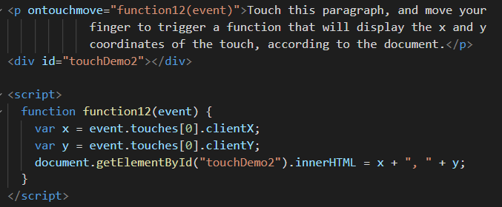
TouchEvent
ontouchmove
Executes JavaScript when a user moves a finger over an element

Slide 28
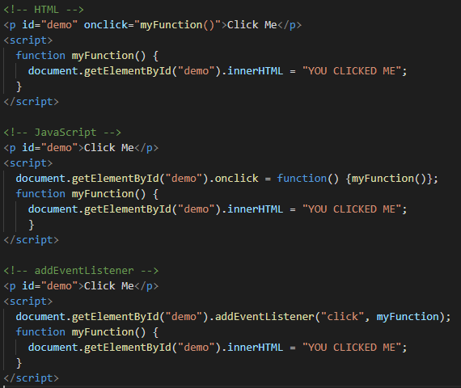
3 ways to code events
Click Me
YOU CLICKED ME

Slide 29
References:
w3schools.com/jsref/dom_obj_event.asp
https://www.tutorialspoint.com/javascript/javascript_events.htm
https://www.geeksforgeeks.org/javascript-events/

